Slide 1
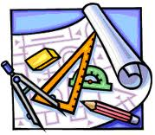
工程图学 ENGINEERING GRAPHICS

Slide 2
王 运巧 Wang Yunqiao Teacher Wang Wang Lao Shi
机械学院工业设计系
Department of Industrial Design, School of Mechanical Engineering & Automation (SMEA),
BeiHang Univ.
助教: 高磊 学长
Mr. Gao Lei

Slide 3

课前调查
https://tp.wjx.top/vj/Q1uCcwE.aspx

Slide 4
第一讲 绪论 Lesson 1 Overview
本讲主要内容 Objective of First lesson
工程图的重要性Describe why technical drawings are an effective communications system for technical ideas about designs and products.
工程图的发展历史Discuss the historical development of engineering graphics.
图学的重要概念Define important terms related to graphics communications.
工程图标准和规范Define standards and conventions as applied to technical drawings.
课程要求 Course requirements

Slide 5
1.1 工程图的重要性
工程图是表达设计过程的完整的实际语言，用于：
交流设计思想（Communicating ）
解决问题 （Solving problems ）
快速准确描述物体（Quickly and accurately visualizing objects.）
执行分析 （Conducting analyses. )

Slide 6
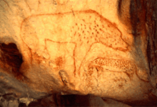
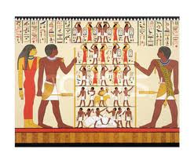
人类的表达和交流系统
语言和文字Spoken language and writing are highly refined communications systems that humans use to express emotions, information, and other needs.
数字Mathematics is an abstract, symbol-based communications system built on formal human logic.
图形Graphics is a visual communications language incorporating text, images, and numeric information.
Egyptian hieroglyphics were abstract pictures used for communication.

Slide 7
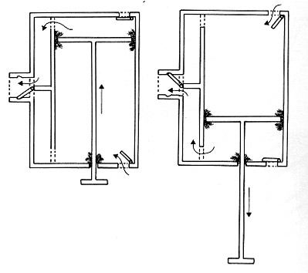
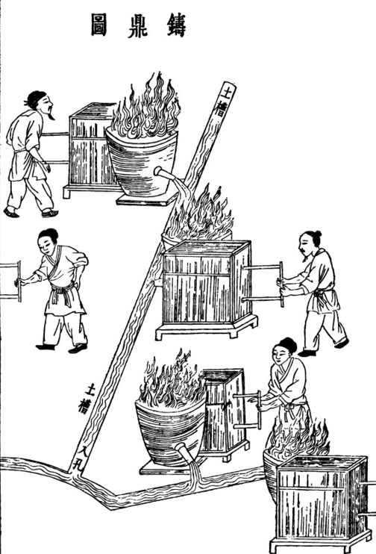
（中国风箱）Chinese bellows
双向鼓风Blew air on BOTH strokes, for a more consistent, hotter flame, resulting in higher temperatures which produce better metal flow in casting, and stronger forgings.

Slide 8
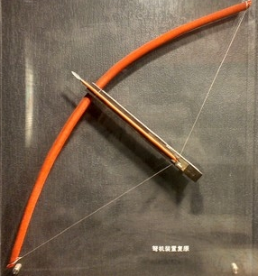
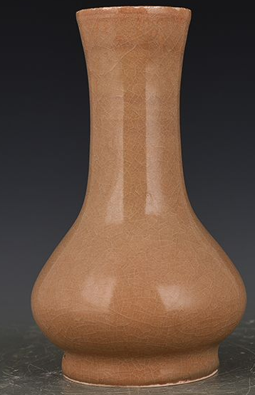
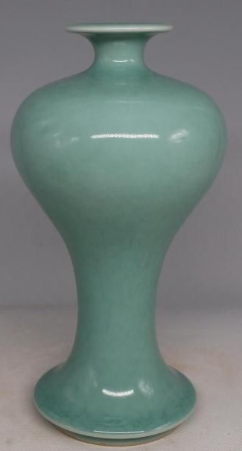
为什么要画工程图（Why Drawing）?

Slide 9
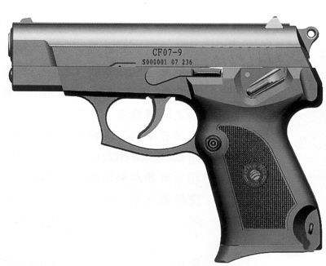
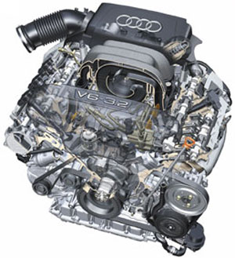
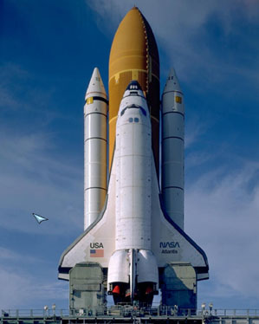

Slide 10
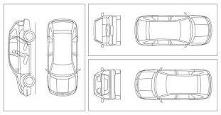
工程界超过90%的设计过程基于图形表达。图形是设计过程的主要交流方法。
In engineering, 92 percent of the design process is graphically based. The other 8 percent is divided between mathematics, and written and verbal communications.

Slide 11
设计师很多时候要图形化考虑问题。 A designer has to think about the many features of an object that cannot be communicated with verbal descriptions. Technical drawings are a nonverbal method of communicating information
Airplane
0D1002002，023020，E20F3030030，230E005885—39…

Slide 12
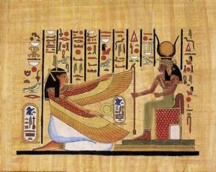
2. 图学发展历史 The History of Graphics Communications
图的历史几乎和人类历史一样长。Drawing is so old that its history is virtually that of humanity and it closely parallels human technological progress.

Slide 13
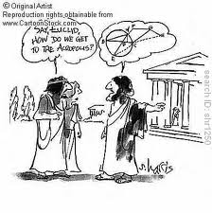
古希腊Ancient Greeks
古希腊在几何方面研究很多，其很多绘图工具到现在还在应用，如圆规和三角板。The ancient Greeks had a great deal of influence on drawing through their work in geometry. Many of the tools still used in engineering, such as the compass and triangles, were developed at this time. Around the year 450 b.c., a type of perspective drawing was developed by foreshortening and converging parallel lines in their drawings. There was very little development in art and drawing from Christ’s time until the Renaissance

Slide 14
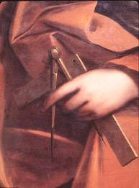

古希腊人认为可以用几何解释宇宙，这类似中国古代天圆地方的思想。
The SQUARE is an instrument adapted for plane surfaces only, and therefore appropriate to Geometry, or measurement of the Earth, which appears to be, and was by the Ancients supposed to be, a plane. The COMPASS is an instrument that has relation to spheres and spherical surfaces, and is adapted to spherical trigonometry, or that branch of mathematics which deals with the Heavens and the orbits of the planetary bodies. The SQUARE, therefore, is a natural and appropriate Symbol of this Earth and the things that belong to it, are of it, or concern it. The Compass is an equally natural and appropriate Symbol of the Heavens, and of all celestial things and celestial natures.
天圆地方

Slide 15
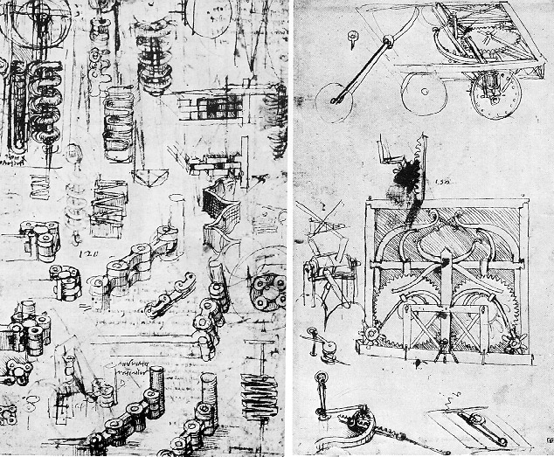
达芬奇提出了关于透视图理论。
Leenardo Da Vinci wrote a treatise on the theory of perspective drawings.
达芬奇手稿
Leonardo Da Vinci’s Manuscript

Slide 16
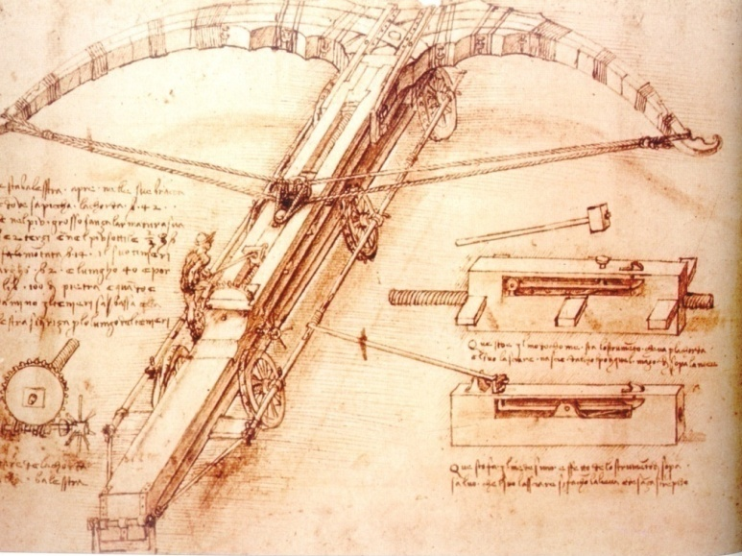
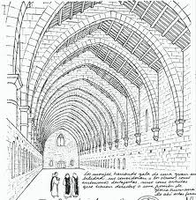
从1400年起，透视技术是图形交流的主要方法。不过人们也逐渐认识到透视图在表达物体的真实形状，特别是出于工程目的时，有很多限制。From the 1400s on, the perspective technique has been the primary method used to communicate graphically. However, people have realized that perspective drawings have limitations in presenting true conditions, especially for technical purposes.

Slide 17
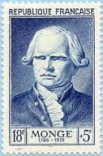
蒙若 Gaspard Monge
法国人蒙若发展了工程图学的理论：画法几何。他使用直角投影和旋转法，以画图的方法而不是通过计算来解决复杂的军事工事问题。Gaspard Monge organized and developed the science of technical drawing called descriptive geometry. He used orthographic projection and the revolution method to solve the complicated fortress problems graphically instead of mathematically.
蒙若200年前创建的以二维平面图形表达三维物体的画法几何学应用至今。Monge developed the science of descriptive geometry in the late 1700s. It is the basis of all types of three-dimensional representations on two-dimensional media used today.

Slide 18
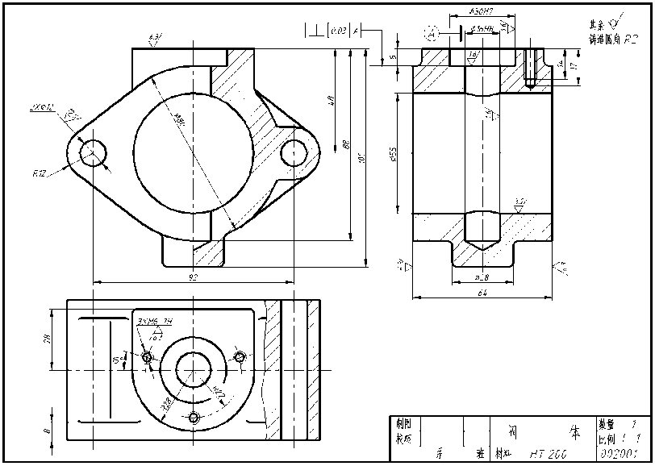
工程图是真实物体、概念或设计结构的可视化表达，可用于后续制造环节。
工程图用于设计、制造、工艺、装配。

Slide 19
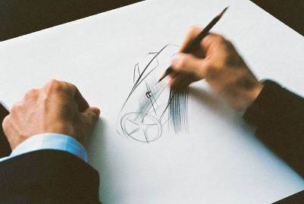
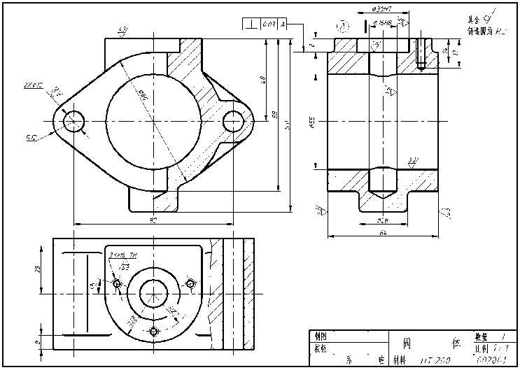
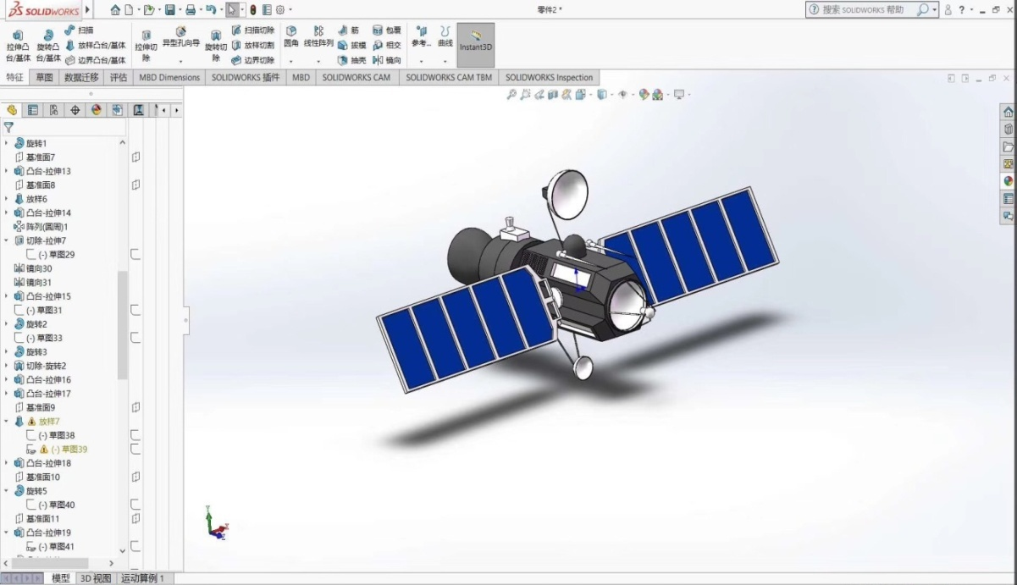
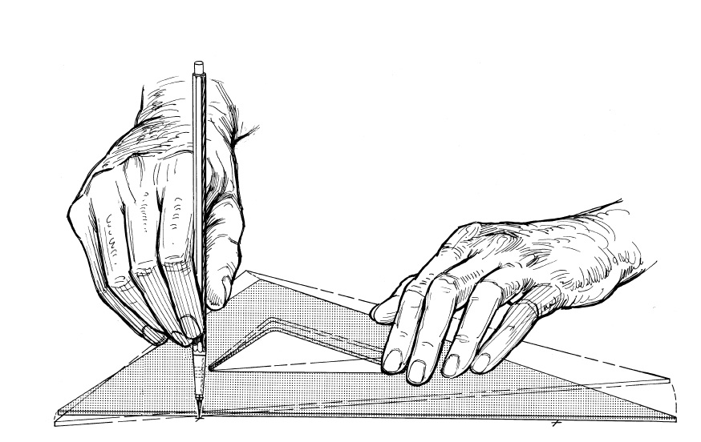
现代工程图学
工程图(Engineering drawings)的类型：
徒手草图(Sketching)
工具绘图(Drafting)
计算机建模(Modeling)
CAD (Computer Aided Design)

Slide 20
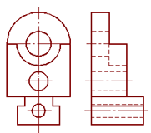

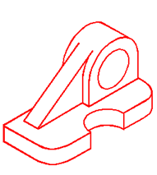
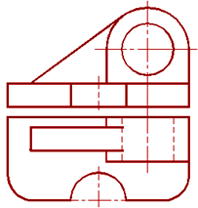
1.3 课程要求
一、学习内容
1. 投影表达

Slide 21
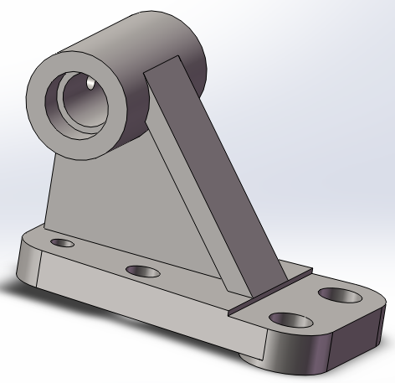
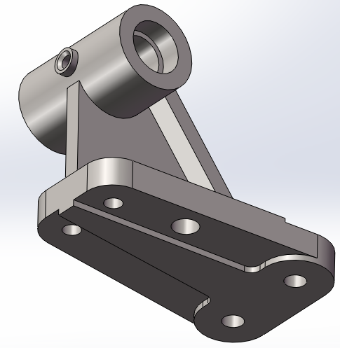
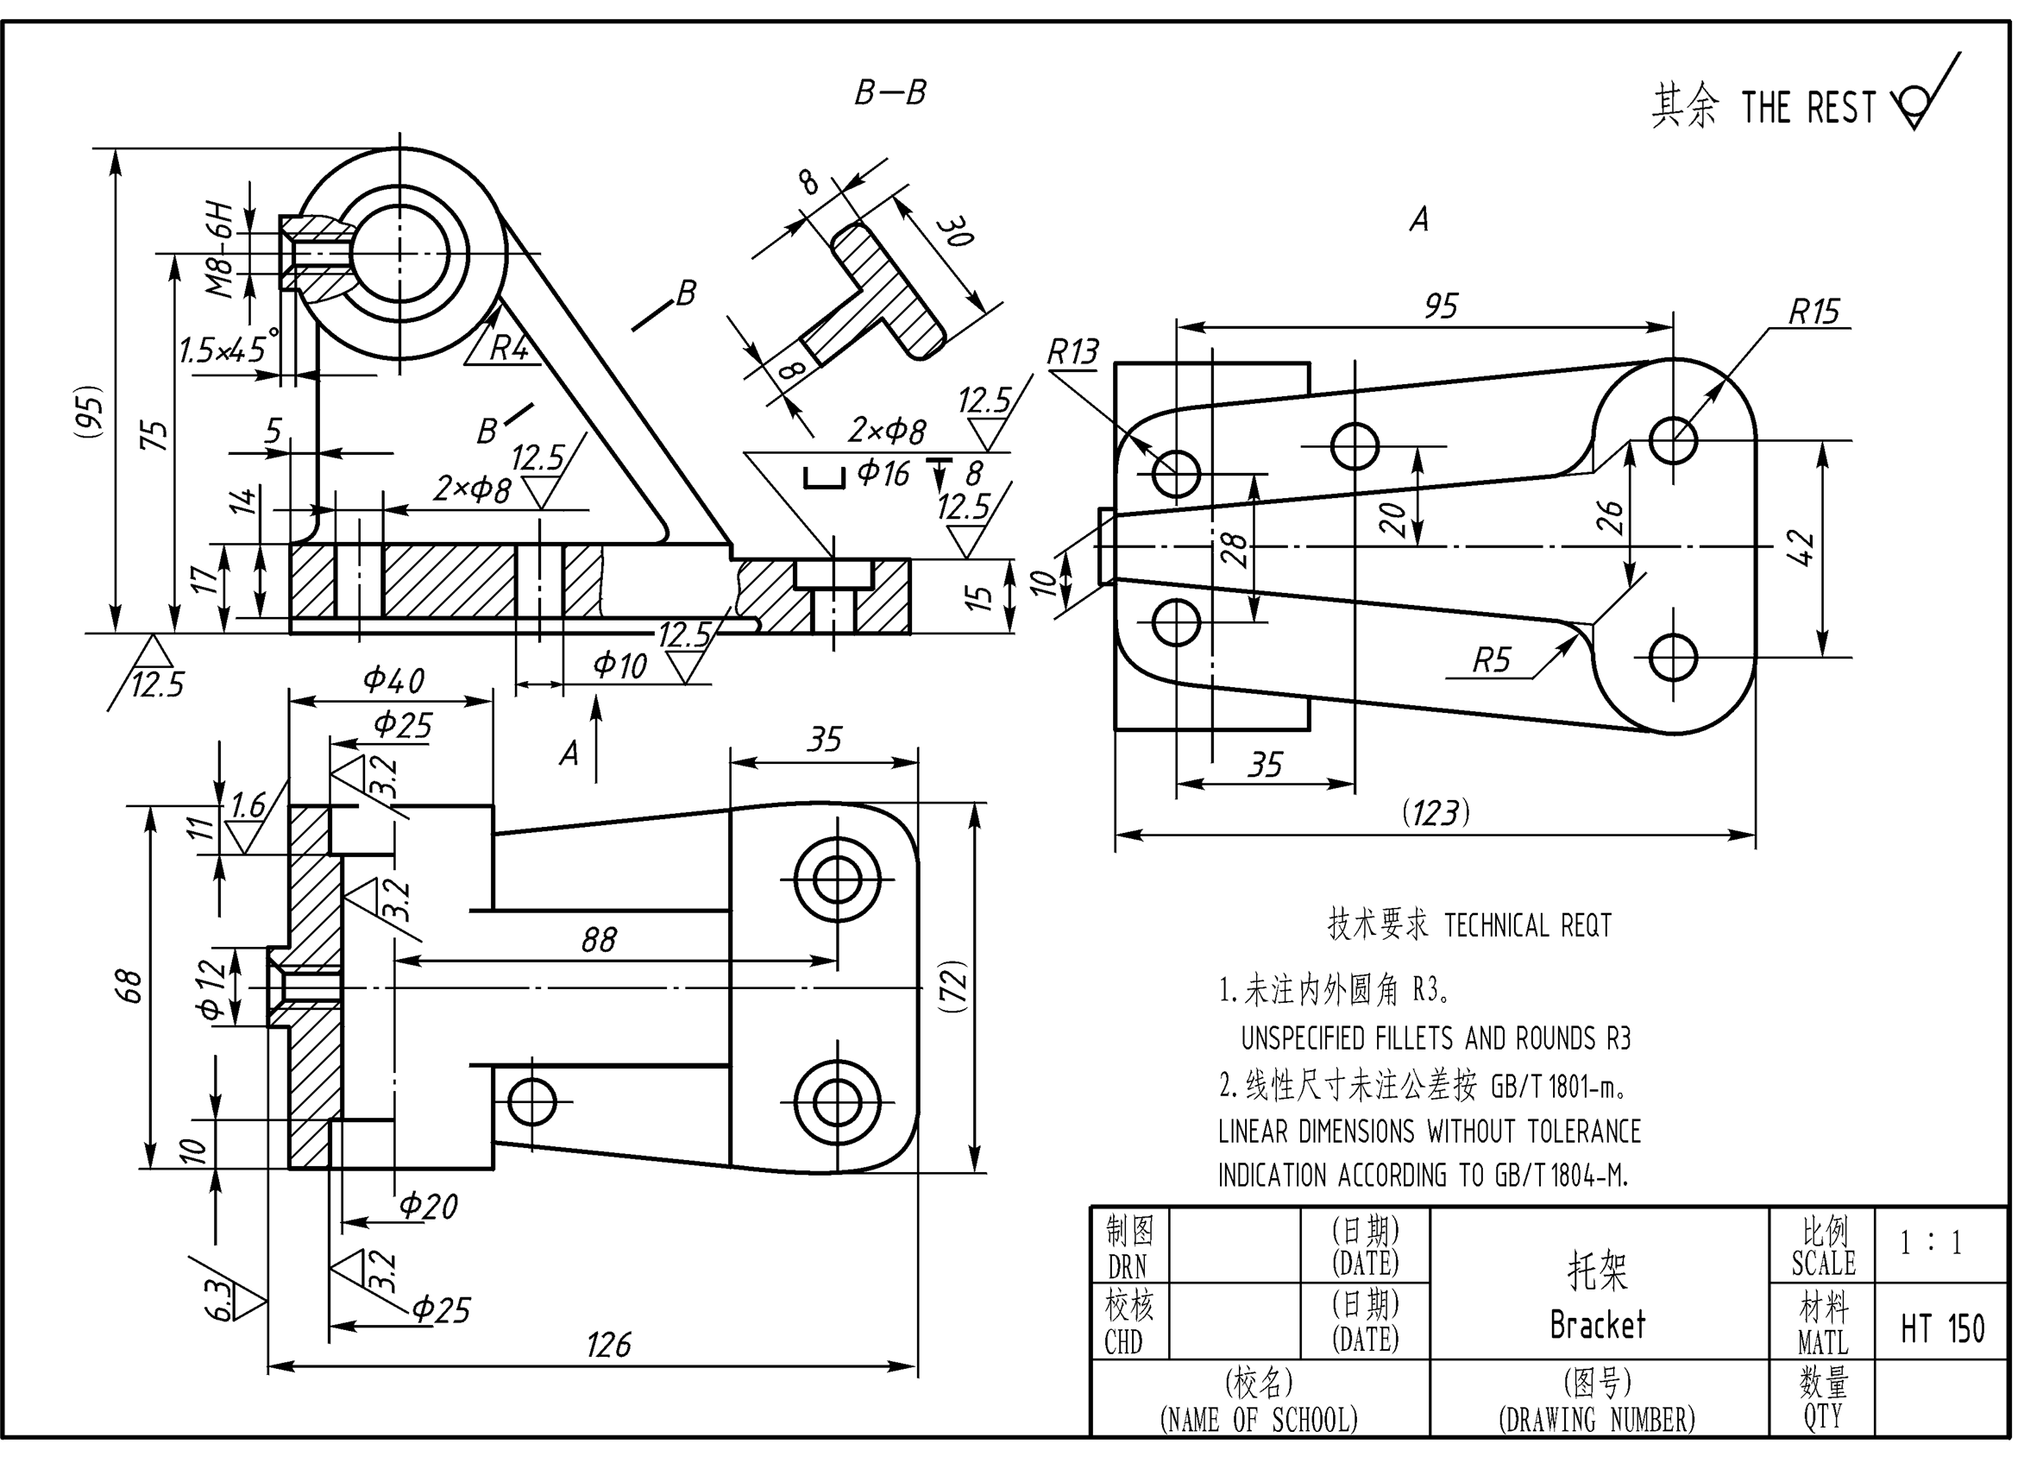
2. 计算机辅助三维建模

Slide 22
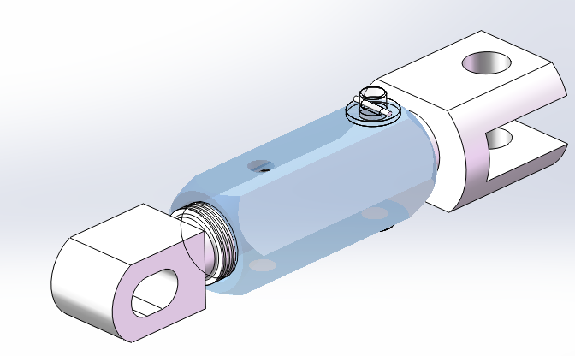
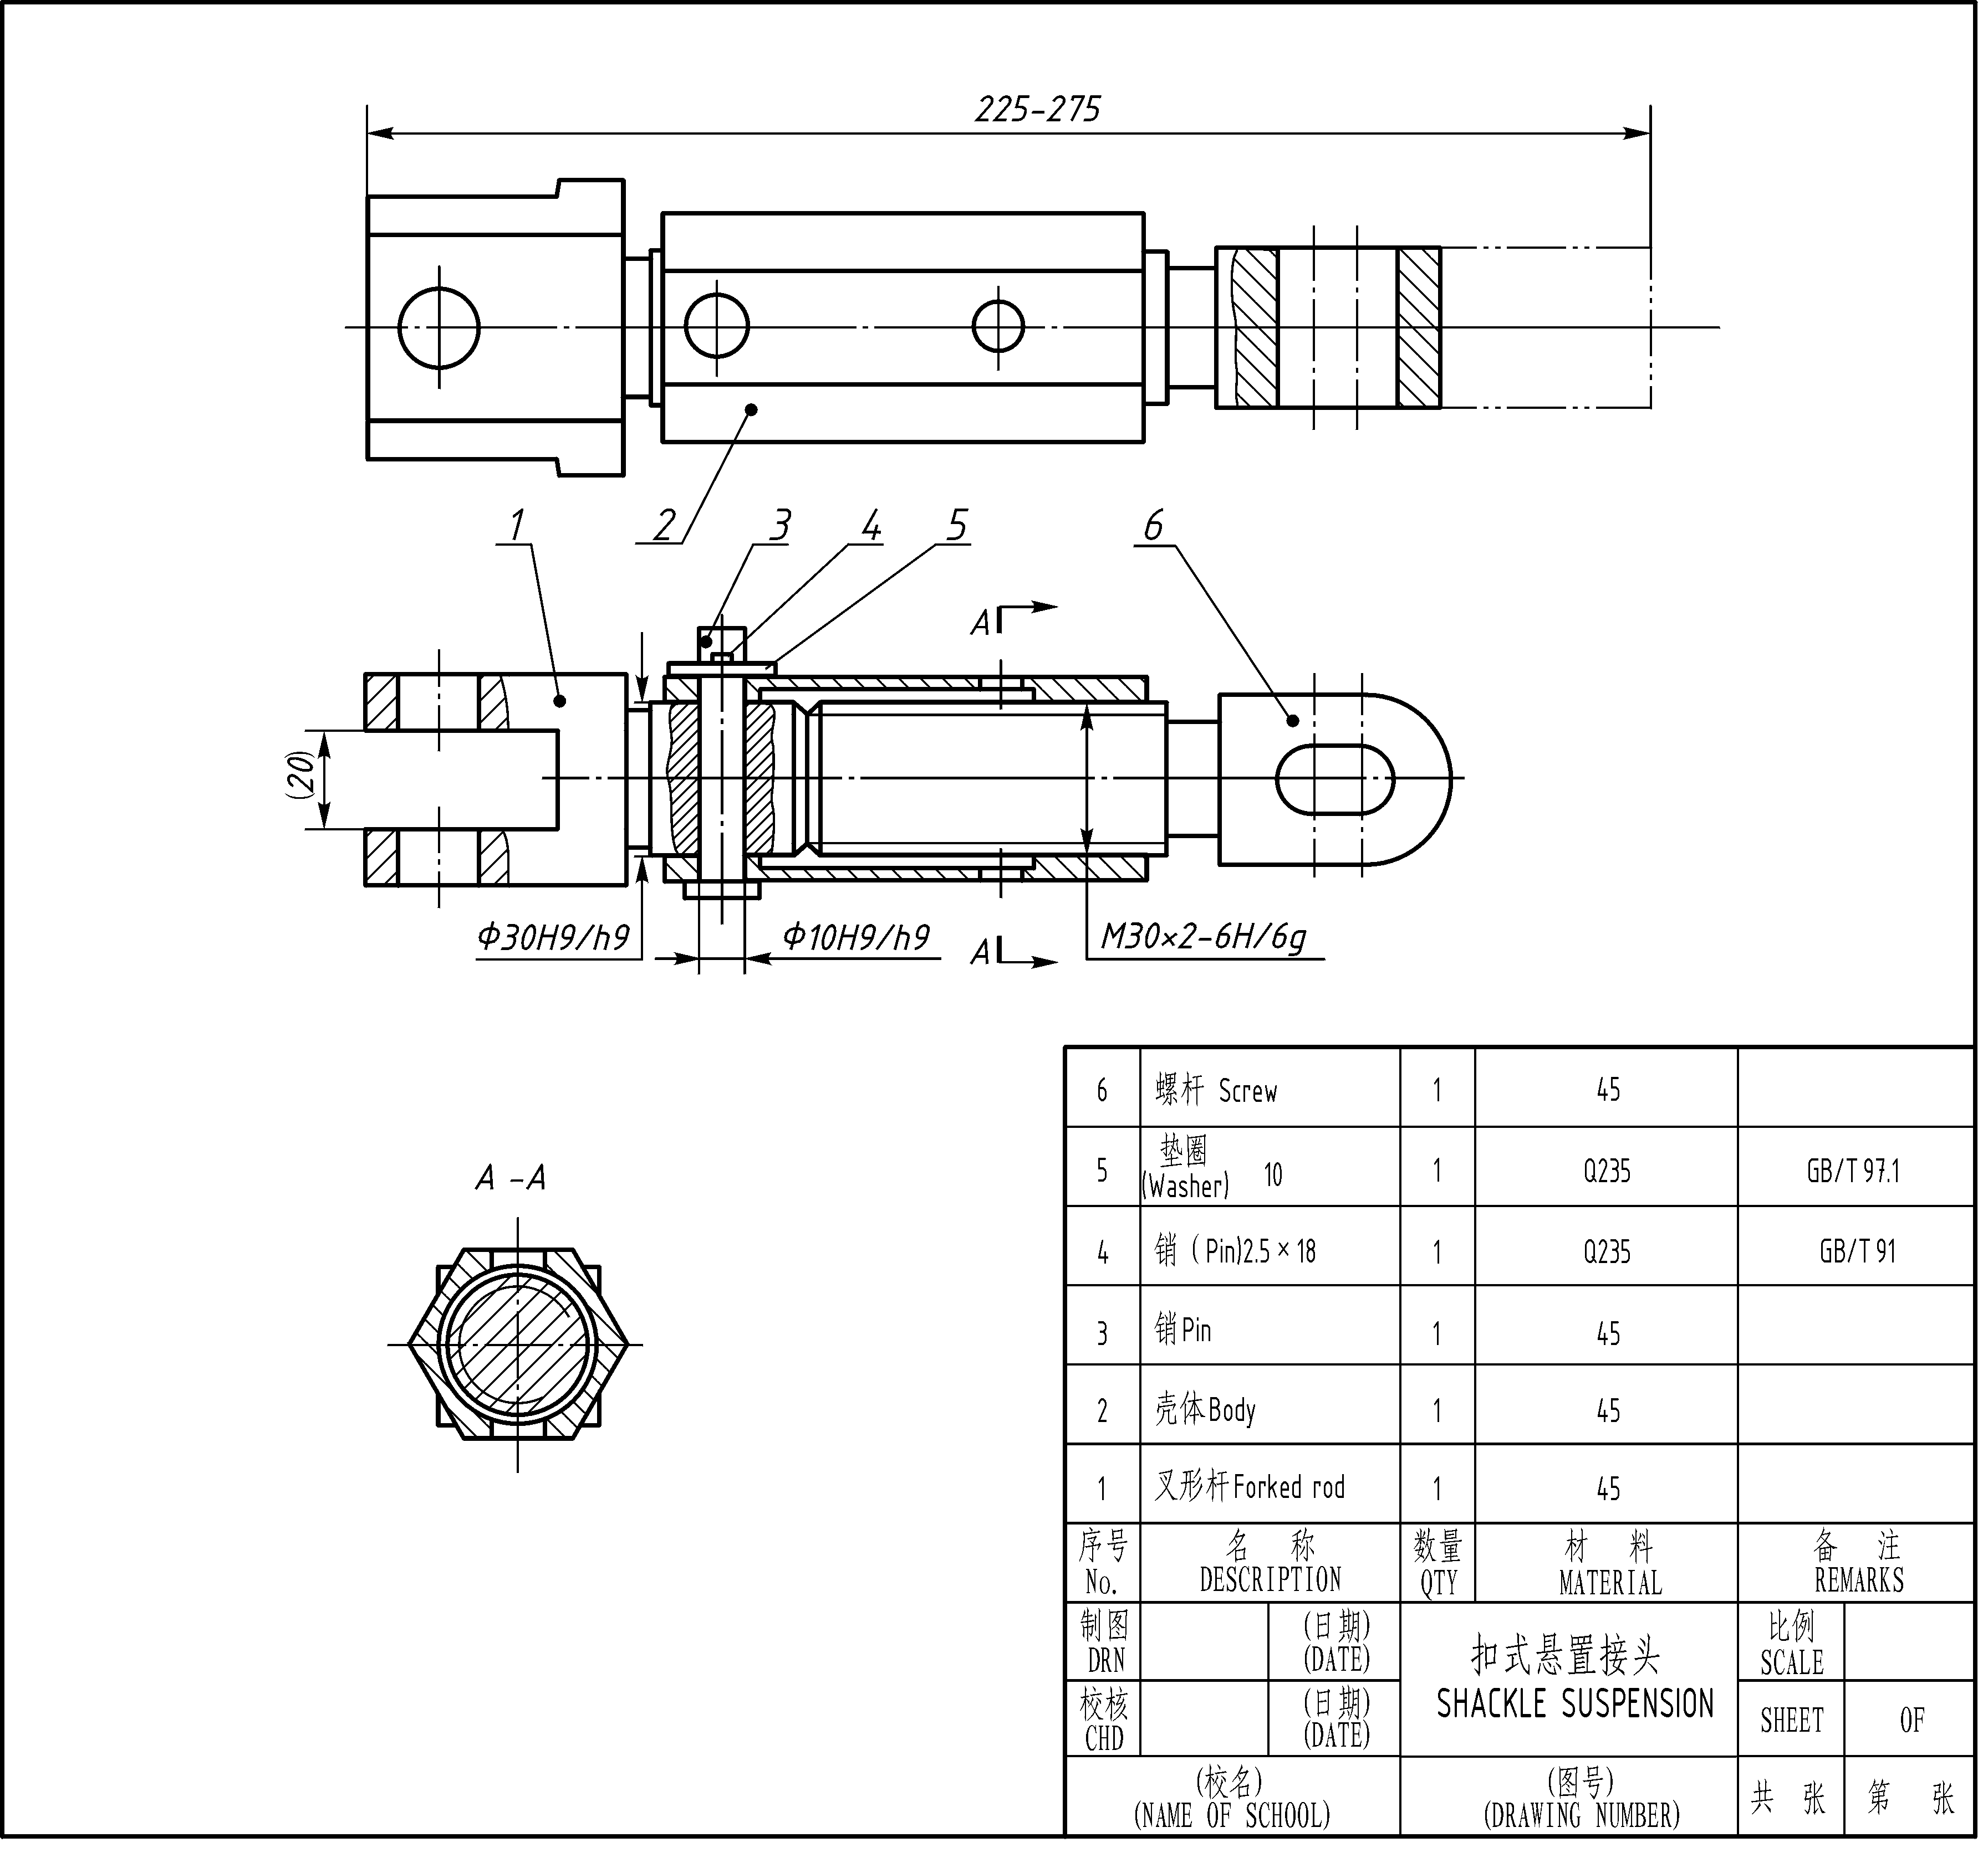

Slide 23
3. 学习工程图标准和规范Standards and conventions applied to technical drawings.
工程图必须按照一定的标准和规范绘制，以便准确交流。 Engineering graphics can also communicate solutions to technical problems. Such engineering graphics are produced according to certain standards and conventions so they can be read and accurately interpreted by anyone who has learned those standards and conventions.

Slide 24
二、学习注意事项 ：
充分发挥想象力（Imagination），从三维立体到二维平面（3D->2D )，从二维平面到三维立体(2D->3D)
（Dimension 尺寸，维数）
认真、按时、独立完成作业，复习讲课内容。
及时改正作业中的错误。保存好每次作业。作业考查不通过者不能参加期末考试。

Slide 25
3.成绩评定(Grade)：
作业和平时测验（Assignment & quiz）50%(包括手工绘图和计算机操作)
期末考试（Final Exam） 50%
作业考查通过和期末考试及格为必要条件。

Slide 26
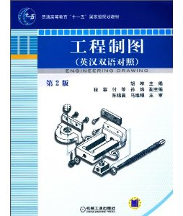
4. 教材Textbook(可以网购或借）
胡琳，工程制图(英汉双语对照)(第2版) 机械工业出版社,2010
(Hu Lin , Engineering Drawing; ISBN: 9787111285953, China Machine Press, 2nd Ed, 2010)
作业我会每次发给大家自己打印

Slide 27
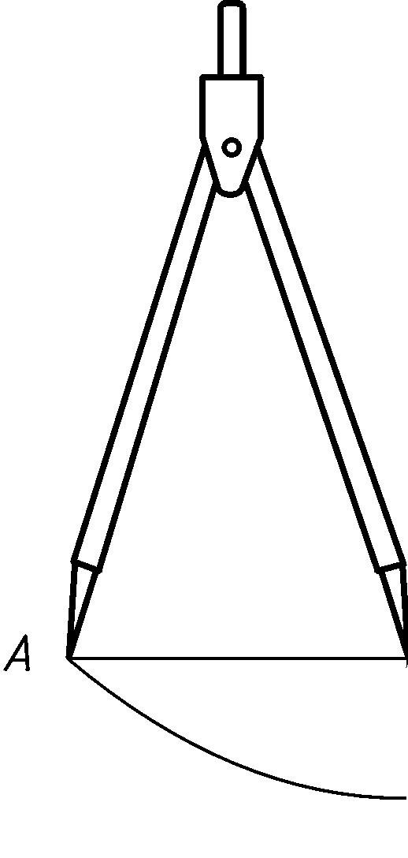
绘图工具 Drawing Instruments
1. 至少两支铅笔At least two pencils (0.3, 0.5, 0.7, 0.9 )
2. 橡皮Eraser
3. 两个三角板Triangles
4. 圆规Compass
5. 分规 Divider
27

Slide 28
绪论小结
学习工程图学，不仅是学习绘制工程图和建立三维模型的工具，也要学习其原理：画法几何。As a student of engineering graphics, you will study and learn to apply the tools used to create engineering drawings and models. Even more important, you will also learn the underlying principles and concepts of engineering graphics, such as descriptive geometry.
学习工程图的标准和规范的必要性You will also learn the standards and conventions that will enable you to create drawings and models that can be read and accurately interpreted by engineers or technologists anywhere.
绘图是一种强大的能力，通过训练可以创建复杂的形状。The ability to draw is a powerful skill. It gives a person’s thoughts visible form. Engineering drawings can communicate complex ideas both efficiently and effectively, and it takes special training to be able to produce these complex images.
工程图不仅仅是技术交流的语言。像任何一种语言一样，它实际上会影响我们的思考方式。知道如何以图形表达思想，会提供更丰富的思考角度和空间。Engineering drawing does more than communicate. Like any language, it can actually influence how we think. Knowing how to draw allows you to think of and deal with many problems that others may not. A knowledge of technical graphics helps you more easily envision technical problems, as well as their solutions. In short, engineering graphics is a necessity for every engineer and technologist.

Slide 29
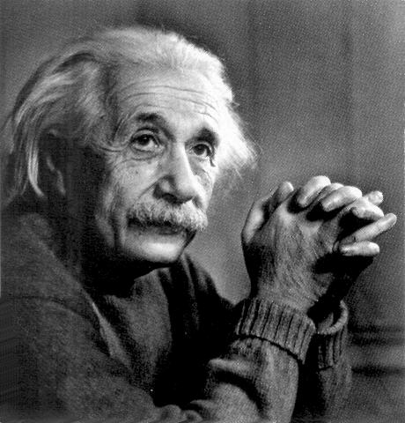
Think Graphically
The words of the language, as they are written or spoken, do not seem to play any role in my mechanism of thought. The psychical entities which seem to serve as elements in thought are certain signs and more or less clear images which can be “voluntarily” reproduced and combined -- this combinatory play seems to be the essential feature in productive thought before there is any connection with logical construction in words or other kinds of signs which are communicated to others
Albert Einstein

